Slide 1
GNS3 images
GNS3 (Graphical Network Simulator 3) is a powerful network simulation and emulation tool that allows you to create and configure complex network topologies using virtual devices, including routers, switches, and firewalls.
To use GNS3 effectively, you'll need images of the actual devices you want to simulate.
Here's a general overview of how to obtain and use GNS3 images:

Slide 2
1. Obtain Images Legally:
GNS3 does not provide images of network devices itself. You need to acquire these images from legitimate sources. For Cisco devices, you should obtain them from Cisco's official website or through authorized channels. Other vendors may have their own sources for virtual appliance images.
2. Supported Image Formats:
GNS3 supports a variety of image formats, including ISO, VMDK, VDI, QEMU QCOW2, and more, depending on the type of device you want to emulate. Ensure that your image is in a format compatible with GNS3.
3. Import Images:
Once you have acquired the necessary image files, you can import them into GNS3 by going to "Edit" > "Preferences" > "QEMU / QEMU VMs." From there, you can add a new QEMU virtual machine and point it to the image file.

Slide 3
4. Set Up Devices:
After importing the images, you can start adding devices to your network topology. Create a new project, drag and drop devices from the GNS3 toolbar onto your workspace, and connect them using virtual cables.
5. Configure Device Settings:
Configure device settings such as RAM, CPU, network interfaces, and other parameters as needed to simulate your desired network configuration.
6. Start and Interact with Devices:
Start your GNS3 project, and you'll be able to interact with the emulated devices just like real ones. You can access their command-line interfaces, configure settings, and test your network.

Slide 4
DOWNLOAD CISCO IMAGES

Slide 5

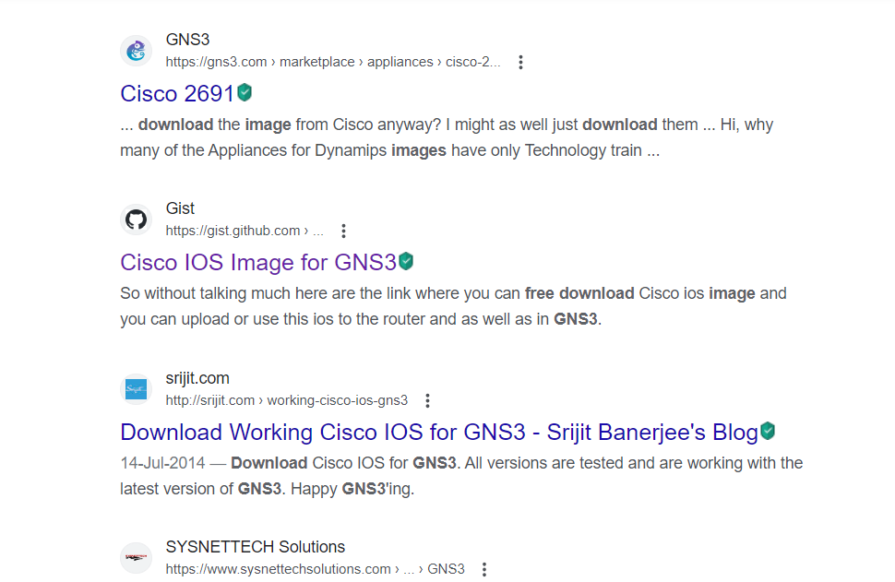
Download from google

Slide 6
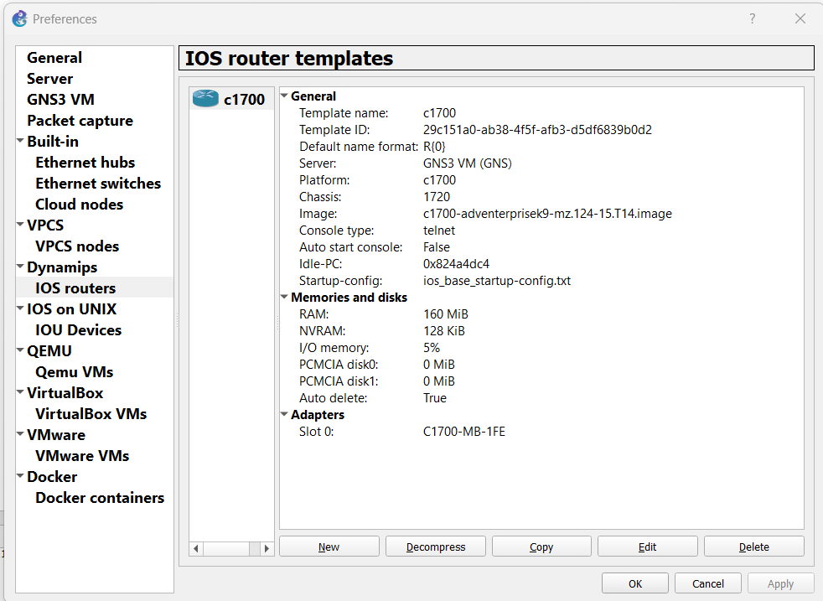
Open gns3
Click on Edit -> Preferences
2. Click on Dynamics
3. IOS routers
2. Click on Dynamics
3. IOS routers
4.Click new , then
5. Click on new image
6.Browse

Slide 7
Capturing telnet password using wireshark
Data is much unsecure in Telnet.

Slide 8
Create a network
Click and drag two routers
Right click on router1 and click Auto-Idle PC
The Idle-PC is a guess at where the Program Counter might be pointing to an idle-loop in the emulated router. When emulator has visits this PC value Idle-Max times, it suspends itself for Idle-Sleep ms to allow other processes to get on their tasks.

Slide 9
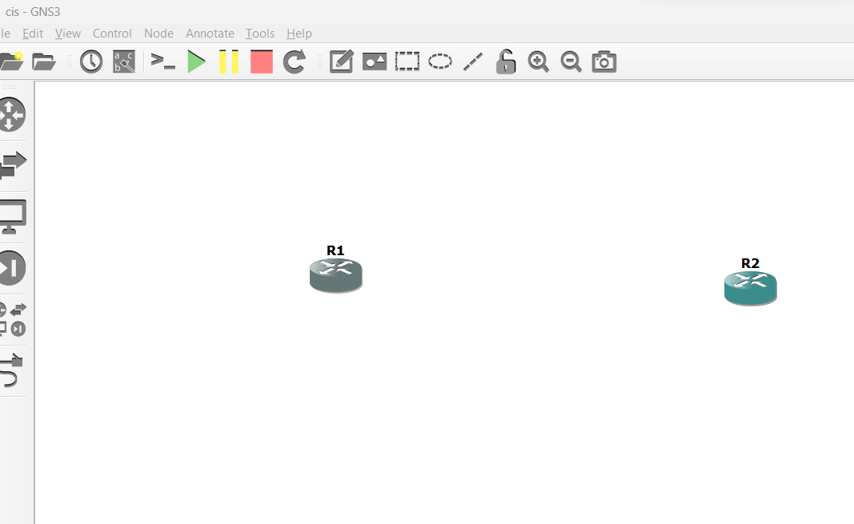
Connect routers using ethernet.
Click start
Open console

Slide 10
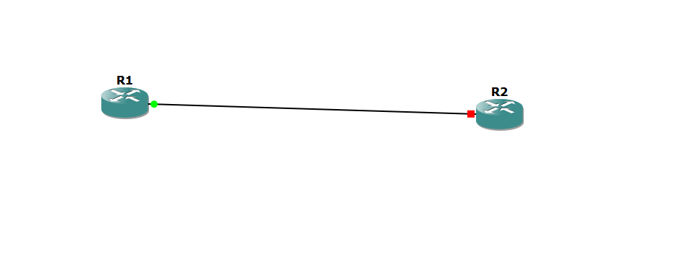
In putty console type command
configure t
int f0
ip add 1.1.1.1 255.0.0.0
no sh
Same has to be done to R2 also.

Slide 11
Then press
Ctrl + Z
2. Then type
sh ip int br

Slide 12
Configure the telnet
First enable password to the router.
Type
configure t
enable password cisco
3. line vty 0 4
4. password cisco
5. login
6. Ctrl+Z
7. wr

Slide 13
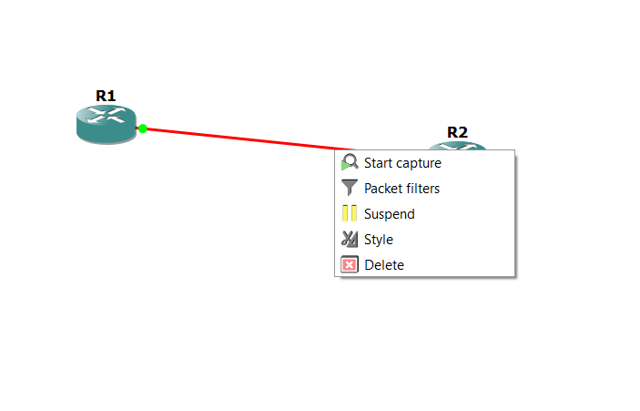
Right click on the ethernet
Click start capture

Slide 14
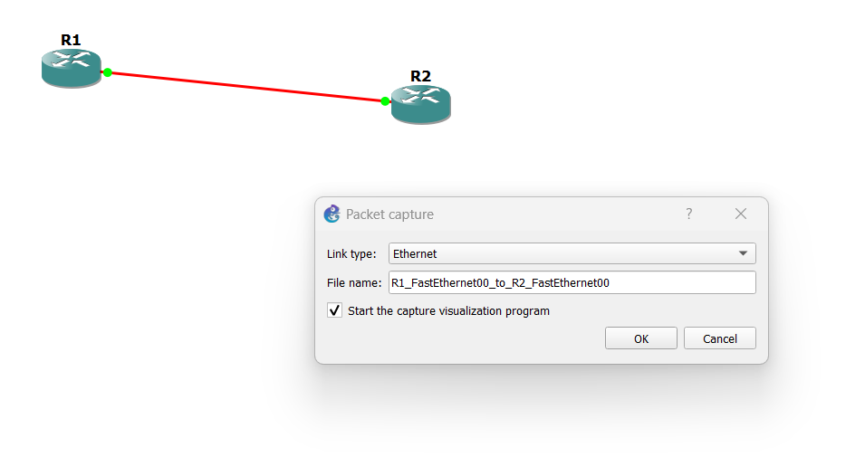

Slide 15
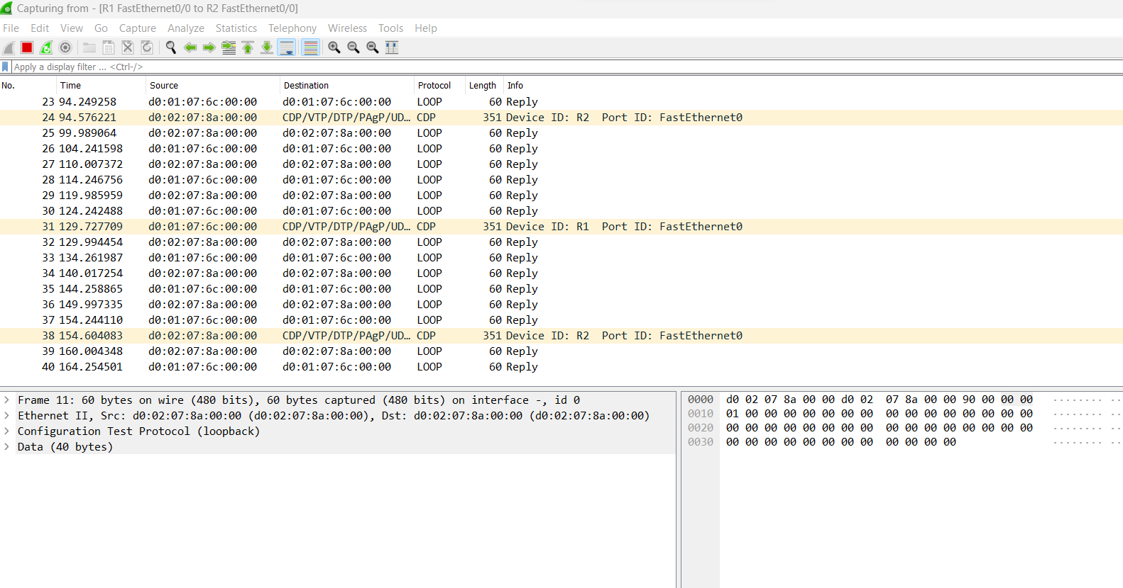

Slide 16
Give telnet command
In R1 console type
telnet 1.1.1.2
Type password (cisco)
Follow TCP session and
Right click
Click follow tcp stream , password is visible

